Slide 1
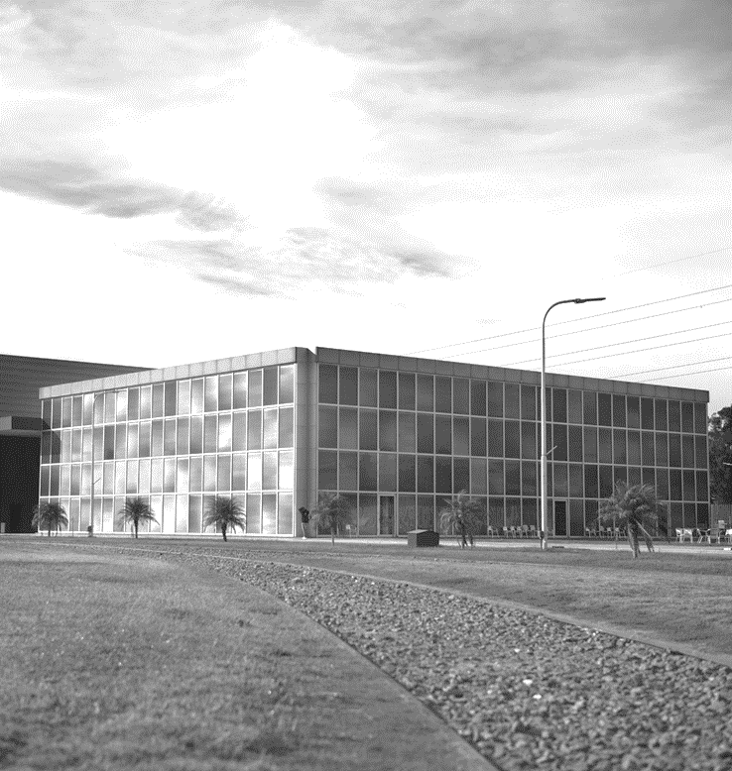
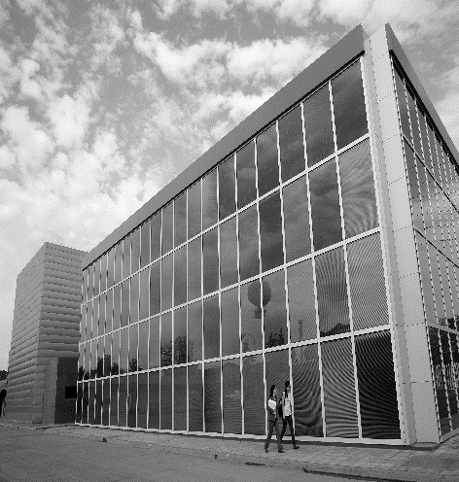
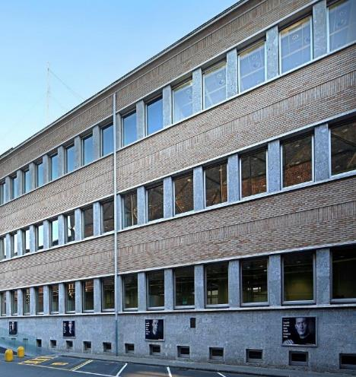
Visit

Slide 2
AGENDA
01
04
TenarisUniversity
TenarisUniversity Mexico
02
05
Learning Model
Measuring Training Effectiveness
03
06
Learning & Delivery Methods
Partnerships
LET’S GO!

Slide 3
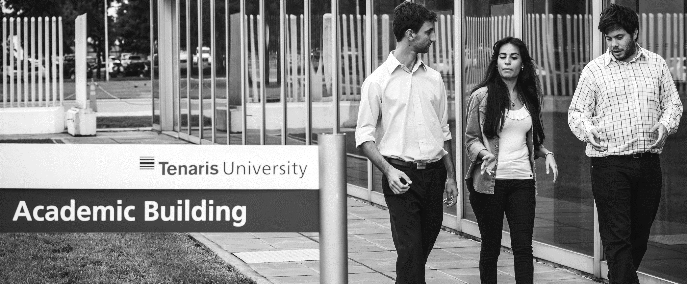
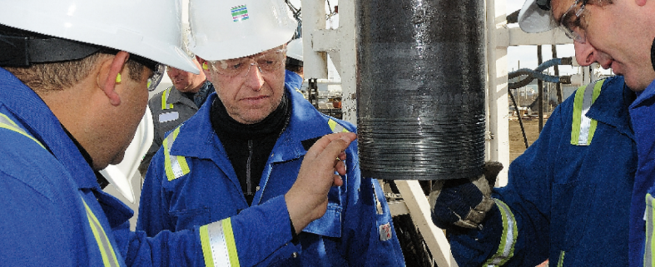
01
TENARISUNIVERSITY

Slide 4
TENARIS
UNIVERSITY
MISSION
OBJECTIVES
Build and sustain Tenaris’ competitive advantage by capturing, organizing, enriching and transferring knowledge assets.
Maintain and grow the company-wide knowledge management system.
Promote learning opportunities to targeted external constituencies.
Help attract, develop and retain Tenaris leaders.
Develop cutting-edge advanced technical knowledge.
Provide employees with required competencies and skills.

Slide 5
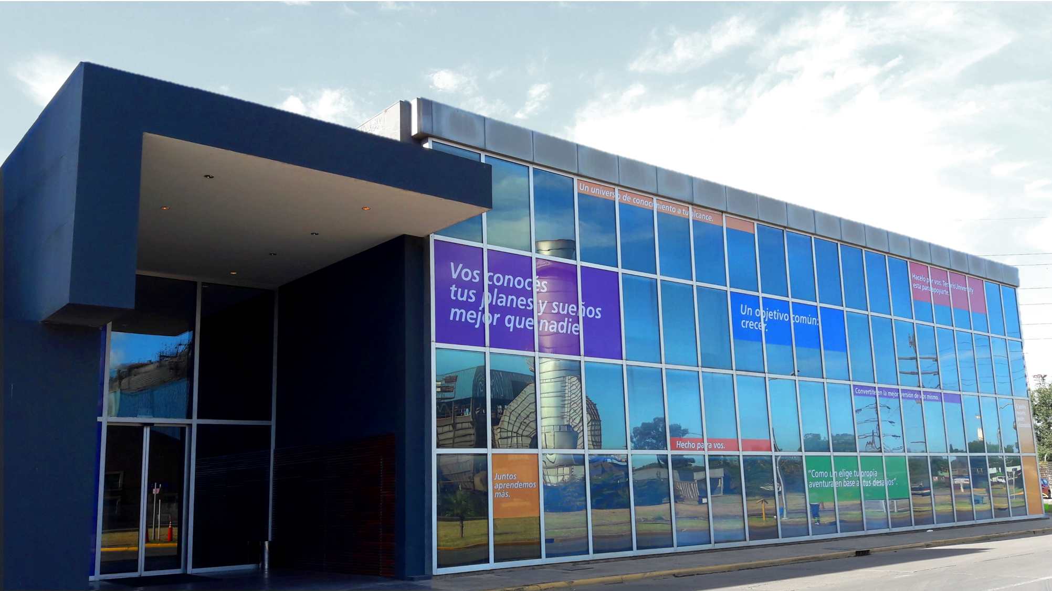
TENARISUNIVERSITY
ORGANIZATION
Founded in 2005 and serving over 23,600 employees
One million training hours per year
1,355 pathways published
500+ classroom courses
Last update: 2022

Slide 6
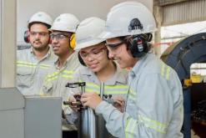
TENARISUNIVERSITY’S
CHALLENGES
01
04
07
One global message for highly dispersed audience.
Training is often needed in local languages, not only English.
Incorporate ever changing technological innovations to courses.
02
05
Employees differ by country, cultures, ages, academic backgrounds,
expertise, etc.
Global content delivery must be adapted to local realities.
03
06
Must adapt traditional learning strategies to Generation Y.
Learning delivered to both Shop Floor Employees (Hourly) and staff (Salaried).

Slide 7
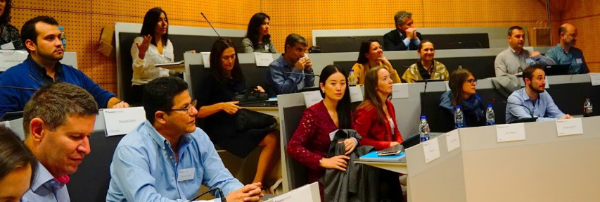
TENARISUNIVERSITY
The key is
the PEOPLE
Knowledge is
our competitive advantage

Slide 8
TENARISUNIVERSITY
ORGANIZATION
Corporate Structure
Industrial School
Learning Experiences
Digital Transformation
School of Management
Business School
TU Network
14 Regional Centers
Brazil • Canada • China • Andean • South East Asia • Middle East • Sub-Saharan Africa • Italy • Japan • Mexico • Romania and others Europe • Southern Cone • USA • Western Europe

Slide 9
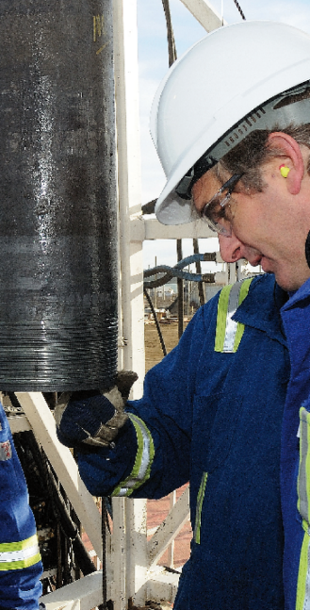
02
LEARNING
MODEL
FOR
STAFF
FOR
SHOP FLOOR EMPLOYEES

Slide 10
LEARNING MODEL
FOR STAFF
Learner Centered
Easy Access to Content
Social Learning

Slide 11
LEARNING APPROACHES
FOR STAFF
Mandatory Training
Suggested
Training
Self-Learning
Social Learning

Slide 12
LEARNING MODEL
FOR SHOP FLOOR EMPLOYEES
DEVELOPMENT PLANS
Training for Shop Floor Employees is one of the main differentiator of TU.
The objective is to have one Industrial System.

Slide 13
LEARNING MODEL
FOR SHOP FLOOR EMPLOYEES
DEVELOPMENT PLANS
Coating
Cold Drawn
Component Center
Cylinders
Direct Reduction
End Protectors
Equipments
Finishing
Fittings
Forming & Welding ERW
Forming & Welding SAW
Galvanizing
Heat Treatment
Hot Rolling
Hot Rolling Tools
Industrial Fluid Services
Logistics
Maint.Electric / Electronic
Maint.Mechanic / Electric
Maint.Mechanic / Hydraulic
Maint.Electric Workshop
Maint.Electronic Labs
Maint.Mechanic Assembly Wk
Maint.Mechanized Wk
Maint.Metal Working Wk
Maint.Vehicles Wk
Power Generation & Dist.
Product Labs
Scrap
Special Jobs
Steel Making
Sucker Rods
Upsetting
Warehouse

Slide 14
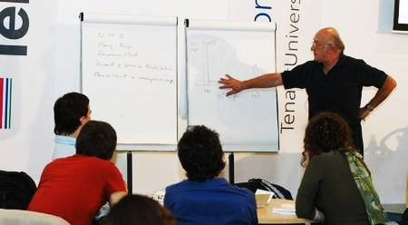
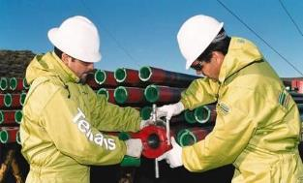
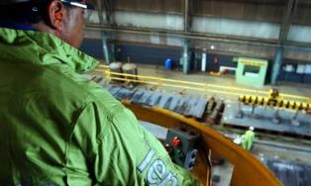
LEARNING MODEL
FOR SHOP FLOOR EMPLOYEES
Training over 16,000 Shop Floor Employees around the world
370 global courses in 11 different languages
Development plans for each of the major job families
indicating the right training for each job
KNOWLEDGE
SKILLS
AUTONOMY
+ Courses
+ OJT
+ Experience
Global
and regional courses
Simulators
Workshops
Work Instruction
Risk Analysis
Quality Procedures
Safety Procedures
Experience in the position
Classroom Courses
(theory + simulation + practice)
On the Job Training
(shadow)
On the Job Training Supervised Operation
(full time)
Experience: Supervised Operation
(part time)
Test
Test

Slide 15
03
LEARNING & DELIVERY METHODS

Slide 16
DELIVERY METHODS
Classroom courses
Webinars
Courses
Events
Others
Recorded training
Digital courses
Videos
On the job training
Training materials
MOOCS
Simulators
OJT & Certifications
Social learning
External courses/Advanced studies
Notes:
CLASSROOM COURSES
Courses
Local classroom courses with globally defined contents. May be taught by local experts or global instructors.
Events
Bringing together employees from around the world for networking and multiple courses.
3. Webinars
Instructors teaching online in real time to employees around the world
4. Others
Recorded Training Videos, Conferences, Curriculum Application Projects, etc.
E-LEARNING COURSES
19% of curricula training + online language courses. Include interactive methods: simulations, videos, games.
EXTERNAL COURSES /ADVANCED STUDIES
In cases of training outside of TenarisUniversity scope or advanced studies, special approval may be granted.
ON THE JOB TRAINING
On the Job Training is primarily used with Shop Floor Employees but some pilots are underway for WC employees.
INFORMAL TRAINING
On the Job Training, Groups, Advanced Search Engine through TenarisWorkplace, etc.

Slide 17
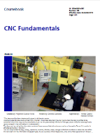
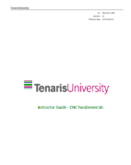
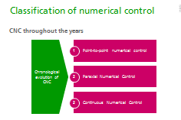
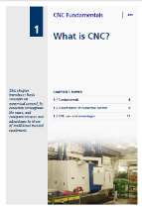
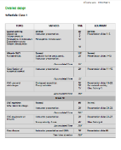
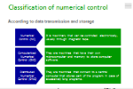
LEARNING METHODOLOGIES
BASIC CLASSROOM TRAINING MATERIALS
INSTRUCTOR PRESENTATION
COURSEBOOK
INSTRUCTOR GUIDE

Slide 19
LEARNING METHODOLOGIES
MOOCs
By joining edX, Tenaris has placed itself at the pinnacle of educational innovation with universities like
Harvard and MIT and other institutions.
PARTNERS
Notes:
Massive Open Online Course
Small Private Online Courses

Slide 20
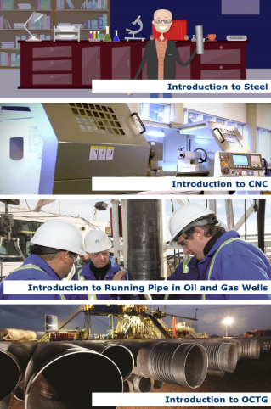
LEARNING METHODOLOGIES
MASSIVE OPEN ONLINE COURSE
+78,354
17%
MOOCs
STUDENTS
COMPLETION
RATE
01
1,500 customers invited to our MOOCs
02
Contribution to World Steel Association
03
Tenaris HR and Social Development branding and positioning
Notes:
Introduction to Comupter Numerical Control (CNC) – Machining enables computers to control manufacturing tolos and how to select program and opeate a CNC maching
Introduction to Oil Country Tubular Goods

Slide 21
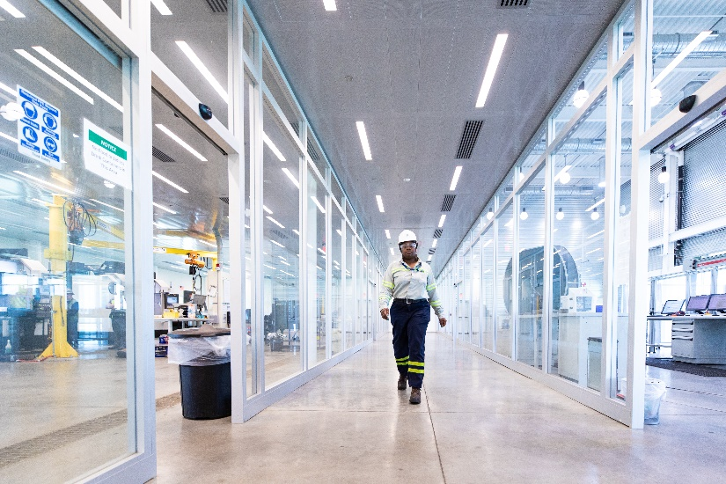
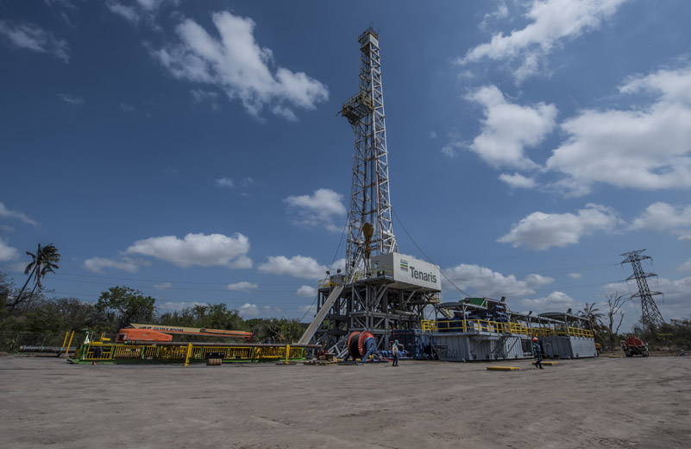
LEARNING METHODOLOGIES
LABS & SPECIAL FACILITIES
LABORATORY
RIG DIRECT™ ACADEMY
Learn technical skills in a safe environment.
Train our employees with the best software available in the market.
Save money preventing on the job learning fails.
The new facility is equipped to make full–scale demonstrations of new products and developments under adverse and extreme conditions.
The test rig facility allow customers from around the world to witness how Tenaris products perform in different applications.

Slide 22
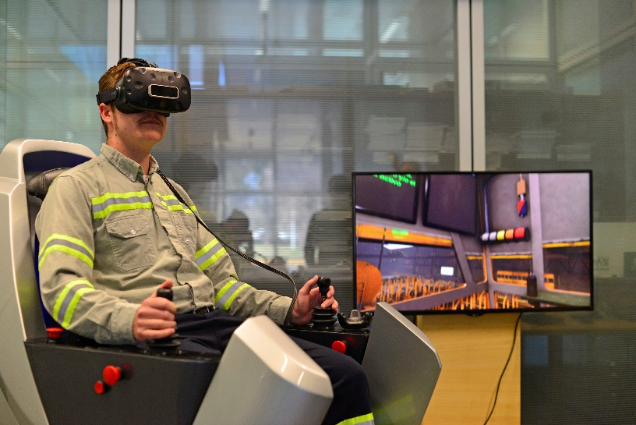
LEARNING METHODOLOGIES
SIMULATIONS
VR Crane Simulator
Immersive Learning environment.
It offers a crane cab experience for the trainee including an operator chair on a motion base that simulates all varieties of movements.
Instructor monitoring
Offers the Instructor the possibility to monitor the action of the student. The instructor station includes a situational display (with a 360° degree birds-eye view) and a control panel that enables the administrator to change environmental conditions in real time.

Slide 23
LEARNING METHODOLOGIES
CERTIFICATIONS
OBJECTIVE
Fulfill theoretical and / or practical training to demonstrate the knowledge and ability to perform of a specific task.
Special Audiences
Internal & External Instructors
AUDIENCES
FISE
LABORATORY
TESA
NDT
HEALTH & SAFETY LEADERS
HSE
ELECTRIC CABIN OPERATORS

Slide 24
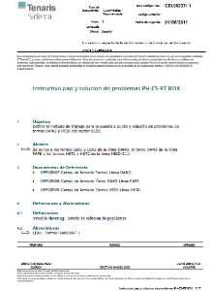
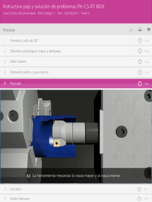
LEARNING METHODOLOGIES
THE OBJECTIVE IS TO IMPROVE THE TRAINING EXPERIENCE OF SHOP FLOOR EMPLOYEES
ON THEIR JOB.
INTERACTIVE WORK INSTRUCTIONS
NEW FEATURES:
Infographics
Videos
3D Animations

Slide 25
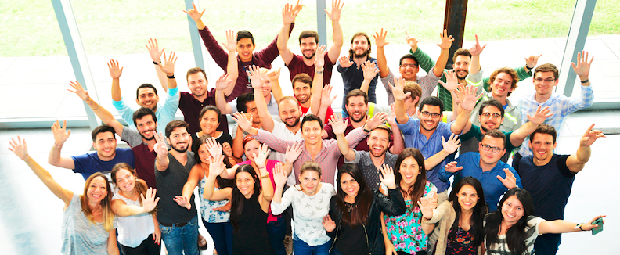
04
TenarisUniversity Mexico

Slide 26
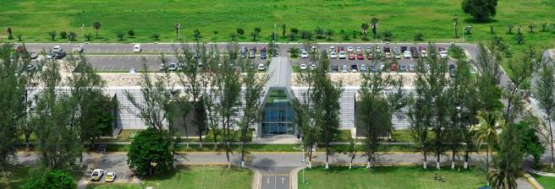
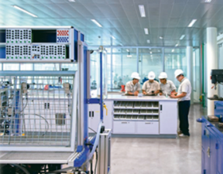
TENARISUNIVERSITY CAMPUSES
ACADEMIC BUILDING
IN MEXICO
TenarisTamsa mill opened in 2010 a 3500 square meter training center that includes a 325 seat auditorium, a board room, ten meeting rooms, nine classrooms and two computer labs. It also includes a workshop where plant shop flor employees hone their skills through simulations and equipment training.

Slide 27
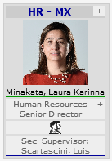
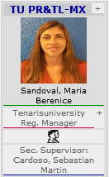
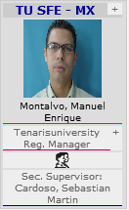
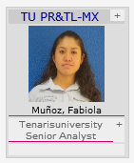
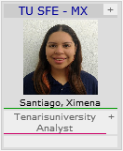
TenarisUniversity | Organization
Special programs dedicated to support Industrial Excellence as a key strategic differentiating driver in Tenaris. Aiming also to combine technical knowledge with soft skills.

Slide 28
Training delivery | Main indicators Mx
Professional & Technical formal training
Training mix by Content
Training Hours 300.3 Th
HSE Training 27%
52 Annual Hrs/Employee
2.5% Training Index
Updated 2022

Slide 29
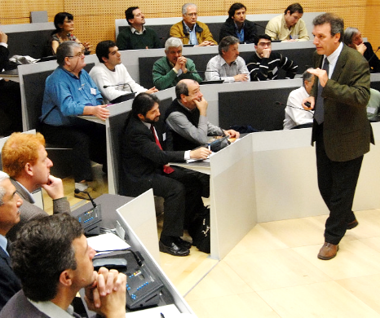
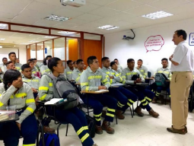
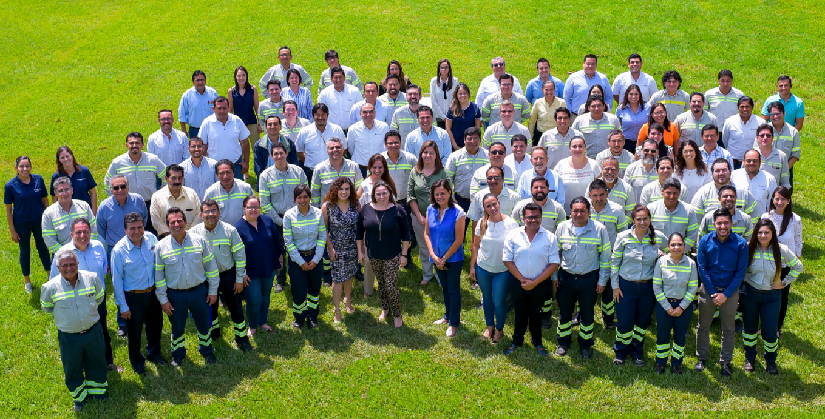
TRAINING DELIVERY
INTERNAL & EXTERNAL
INSTRUCTORS
More than 100 internal and external instructors sharing knowledge and expertise.
Transmitting Organizational Culture
Promoting learning sharing
Enabling growth and development and recognition

Slide 30
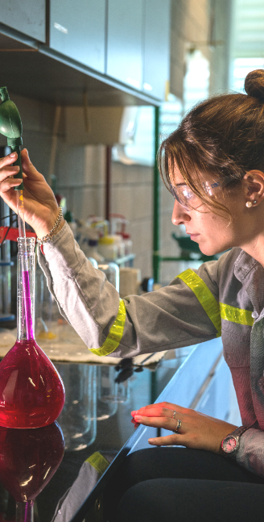
05
MEASURING
TRAINING
EFFECTIVENESS

Slide 31
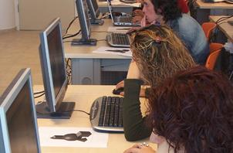
MEASURING TRAINING EFFECTIVENESS
LEVEL 1
LEVEL 2
LEVEL 3 & 4
Satisfaction
Knowledge
Job Application
& Business Impact
Survey
Multiple choice exam
Line KPIs
Certification
Checklist
Application Project
Performance
Evaluation
DURING TRAINING
AFTER TRAINING

Slide 32
MEASURING TRAINING EFFECTIVENESS
Defined problem
Audience
Led by TU representative
HIT
(High Impact Training) Methodology
Part of bigger initiative
KPIs
Clear schedule
Sponsor
PROCESS:
Determine if training is part of the solution
Implement the training actions
Measure, follow up
& report
Identify the problem
Design the program
LESSON LEARNED

Slide 33
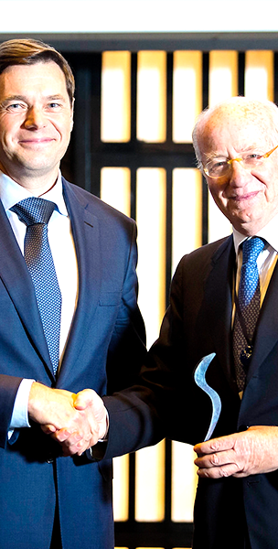
06
PARTNERSHIPS

Slide 34
PARTNERSHIPS
TENARISUNIVERSITY WORKS TOGETHER WITH OTHER INSTITUTIONS

Slide 35
Thank you

